Slide 1
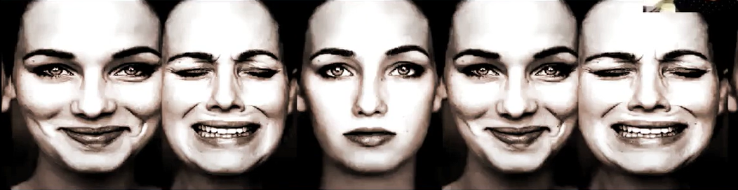
“SPEECH EMOTION RECOGNITION USING DEEP LEARNING”
PROJECT PRESENTATION
MENTOR:-
Dr. Sanjeev Sharma
TEAM MEMBERS DETAILS:-
Divya Garg (2000290100058)
Anshika Gupta (2000290100025)
Amrita Singh (2000290100019)
Group-33

Slide 2
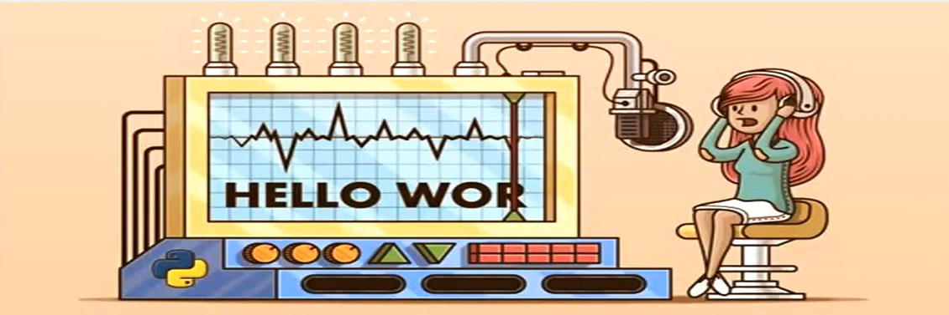
WHY WE HAVE CHOSEN THIS PROJECT?
Emotion detection has become one of the biggest marketing strategies, in which more of the customer plays an important role. So to detect the current emotion of the person and suggest him the apt product or help him accordingly, will increase the demand of the product or the company.

Slide 3
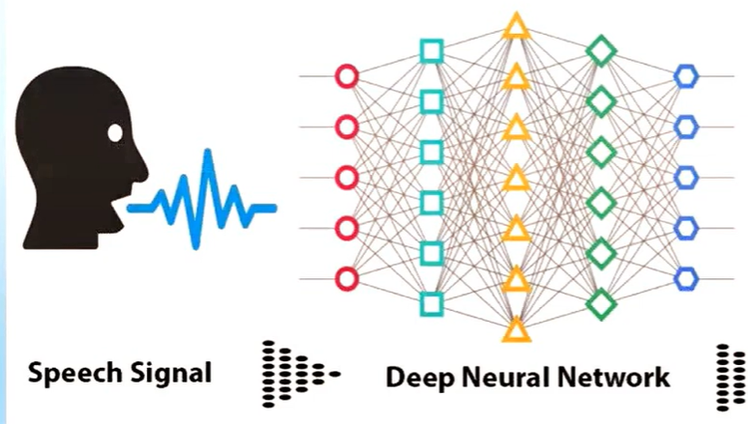
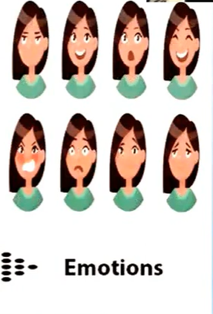
Basic analogy of project

Slide 4
Ideology behind the project
The idea behind creating this project was to build a machine learning model that could detect emotions from the speech we have with each other all the time.
So why not have a emotion detector that will gauge your emotions and in the future recommend you different things based on your mood. This can be used by multiple industries to offer different services like marketing company suggesting you to buy products based on your emotions, automotive industry can detect the persons emotions and adjust the speed of autonomous cars as required to avoid any collisions, etc.

Slide 5
APPROACHES USED
DATASET USED:-
RAVDESS: This dataset includes around 1500 audio file input from 24 different actors. 12 male and 12 female where these actors record short audios in 8 different Emotions.
1=neutral, 2=calm, 3=happy, 4=sad,
5=angry, 6=fearful, 7=disgust, 8=surprised.
Each audio file is named in such a way that the 7th character is consistent with the different emotions that they represent.
CREMA: This dataset has 7,442 original clips from 91 actors. These clips featured 48 male and 43 female actors aged 20–74 from African American, Asian, Caucasian, Hispanic, and Unspecified backgrounds. 12 sentences were read by actors. The statements used one of six emotions (Anger, Disgust, Fear, Happy, Neutral, and Sad) and four emotion levels (Low, Medium, High, and Unspecified).

Slide 6
TESS: TESS stands for toronto emotional speech set [16] in which two actresses (ages 26 and 64) spoke a set of 200 target words with the phrase "say the word _." these words were recorded as they showed each of seven emotions: anger, disgust, fear, happiness, happy surprise, sadness, and neutral. There are a total of 2800 data points, which are audio files. The information is set up so that each of the two female actors and their feelings are in their folders. That's where you can find the audio file with all 200 target words. The audio file is saved in the WAV format.
SAVEE:
The SAVEE (Surrey Audio-Visual Expressed Emotion) database [17] was made by four guys who speak English as their first language. Their names are DC, JE, JK, and KL, and they are between the ages of 27 and 31 and are postgraduate students and researchers at the University of Surrey. Emotions like fear, anger, disgust, happiness, sadness, and surprise have been put into their groups by psychologists.

Slide 7
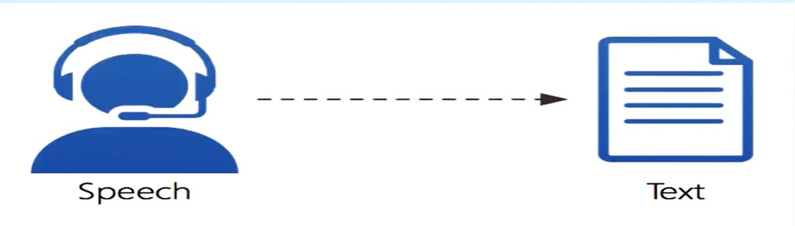
SPEECH TO TEXT TRANSLATION USING SPEECH EMOTION RECOGNITION API:-
Initially We tested the Audio by translating it back into the text mode using Speech emotion API to know what the audio is all about.

Slide 8
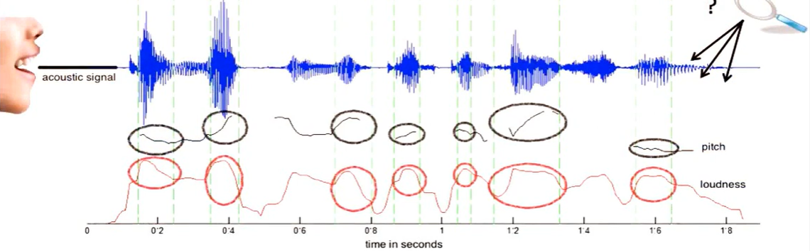
Analyzing Audio Signals:-
Second step is to test out the audio files by plotting out the waveform and the spectrogram to see the sample audio files.

Slide 9
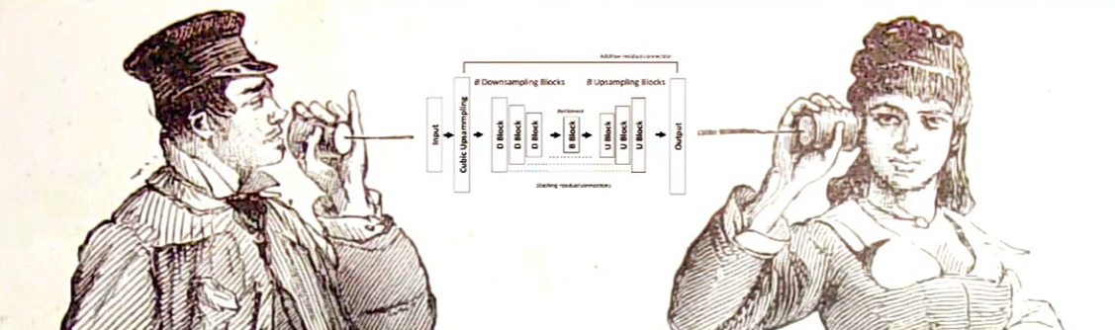
MASKING AND CLEANING OF AUDIO FILES:-
Next Step is to clean the audio files by lowering down the sample rate and removing the unwanted noise around the raw audio via MASKING.

Slide 10
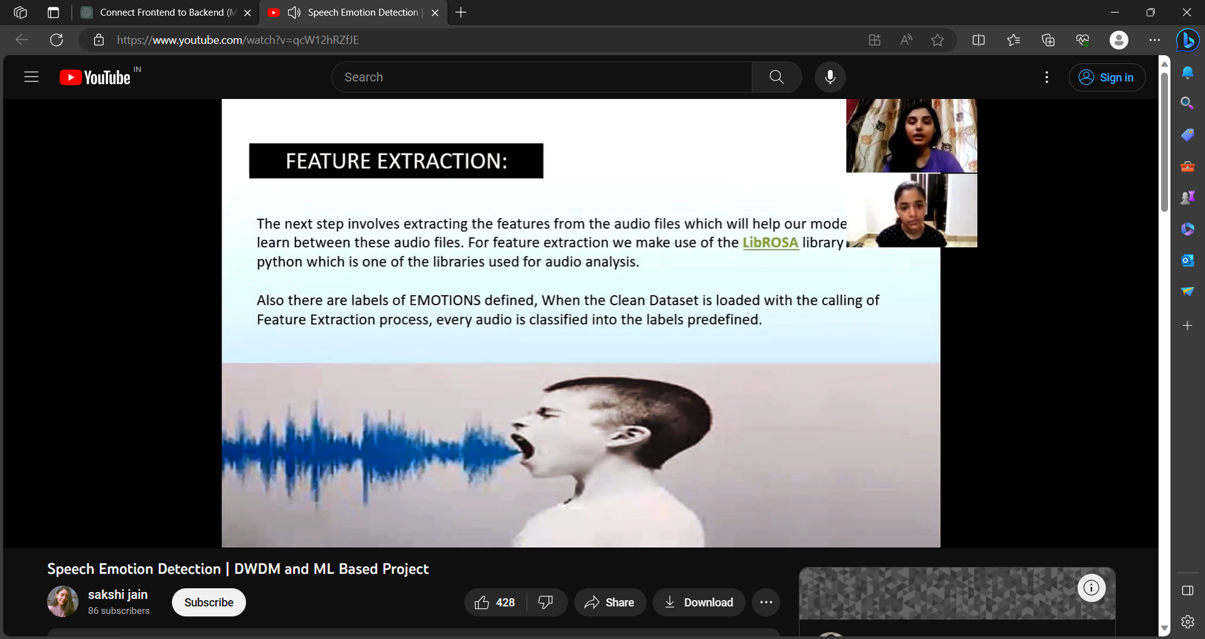
FEATURE EXTRACTION:-
The next step involves extracting the features from the audio files which will help our mode of learn between these audio files. For feature extraction we make use of the LibROSA library in python which is one of the libraries used for audio analysis.
Also there are labels of EMOTIONS defined, When the Clean Dataset is loaded with the calling of Feature Extraction process, every audio is classified into the labels predefined.

Slide 11
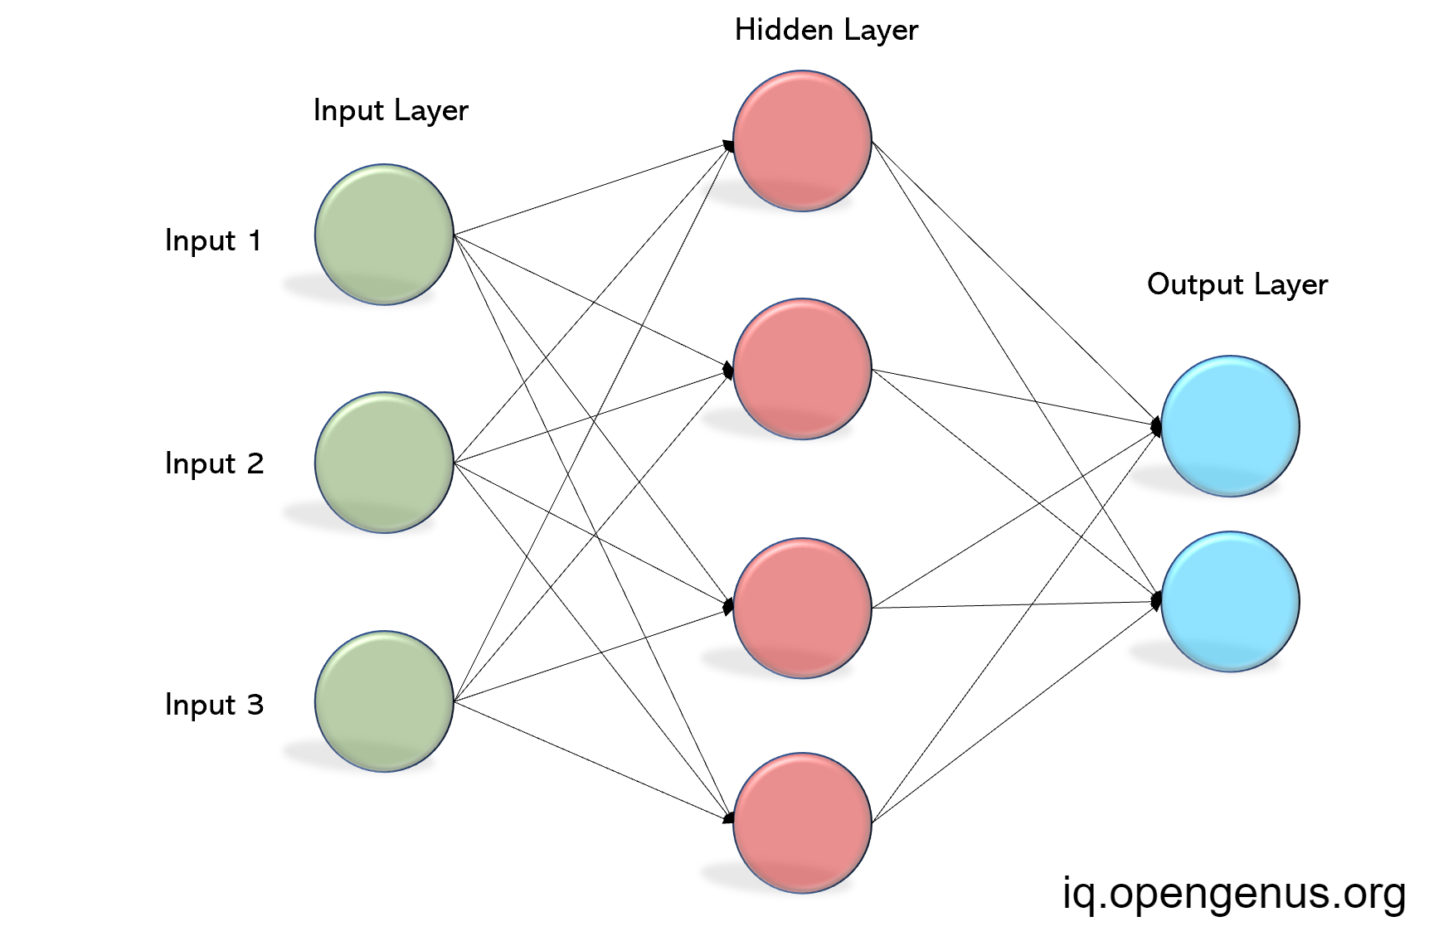



BUILDING THE MODEL:-
Since the project is a classification problem, Multilayer Perceptron seems the obvious choice. We chose this model to predict the right emotions.
This classifier connects to a Neural Network. Unlike other classification algorithms such as Support Vectors or Naive Bayes Classifier, MLP Classifier relies on an underlying Neural Network to perform the task of classification

Slide 12
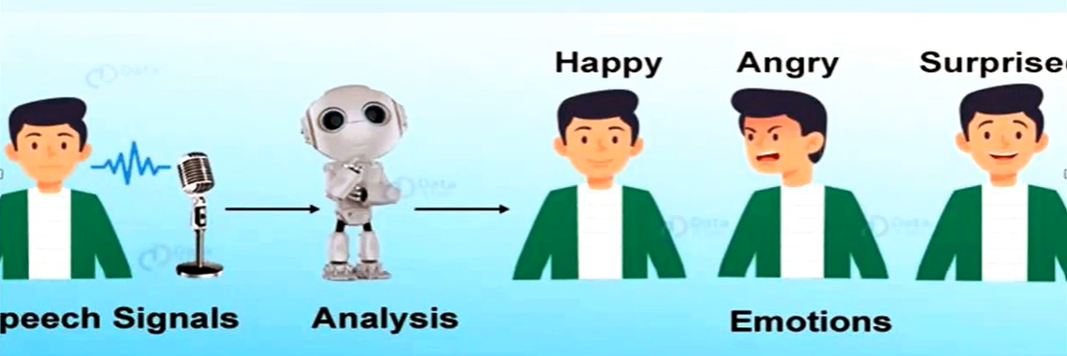
PREDICTIONS:-
After tuning the model, tested it out by predicting the emotions for the test data. Following of the splitting of training and testing data to saving the model. Model is loaded again to predicting the test data and store its result in .csv file along with its labels for mapping individual result to its wav file name.
S

Slide 13
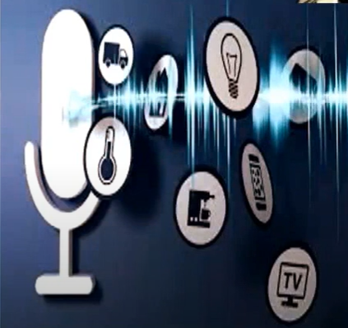
LIVE DEMO FOR PREDICTION
Now we can record the voice of any user via microphone and can then save it as a .wav file. So that later we can load our model to predict the result out of that particular .wav file.

Slide 14
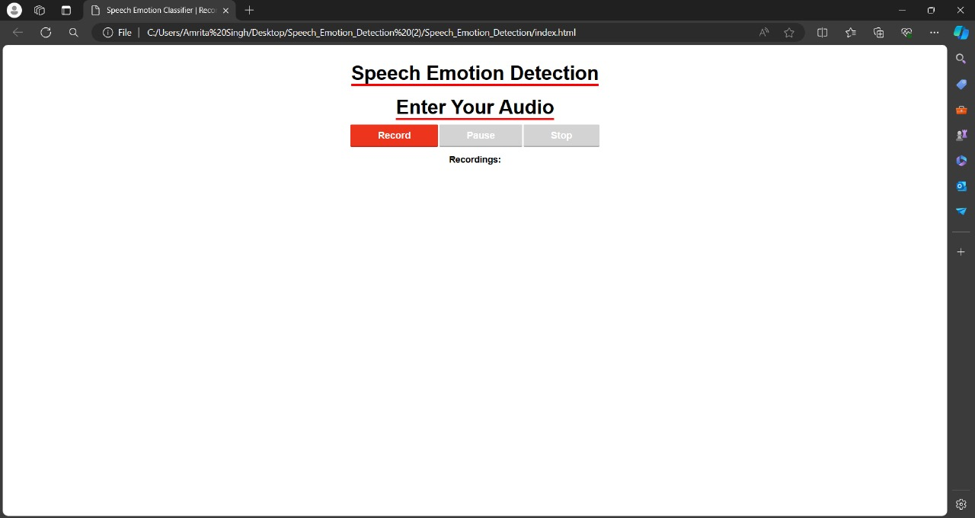
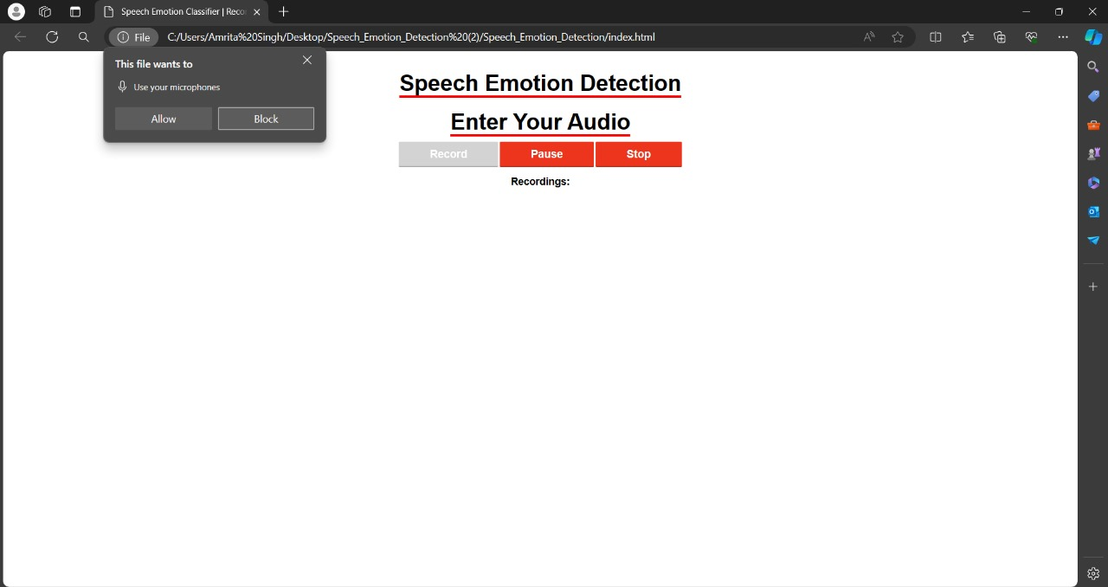
UI INTERFACE

Slide 15
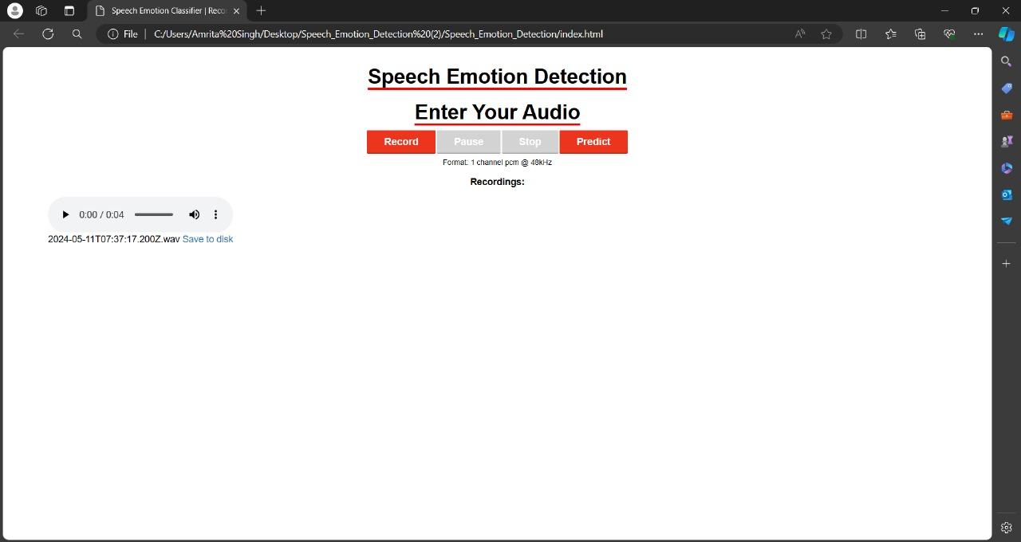


Slide 16
CONCLUSIONS AND CHALLENGES
The literature in speech emotion detection is not very rich and researchers are still debating what features influence the recognition of emotion in speech. There is also considerable uncertainty as to the best algorithm for classifying emotion, and which emotions to class together.
In the real problem, difficult individuals reveal their emotions in a diverse degree and manner. There are also many differences between acted and spontaneous speech.

Slide 17
This model can be used by various apps, online shopping websites and so on to know about the user’s emotions. Further improvements can be made to the model so that it can perform well in real time. For improving the accuracy of the model, we can increase the size of the dataset. The classifier can be embedded in a software or an app so that it can work in real time. Moreover, we look forward to come up with more industrial applications of this model.
Due to less availability of datasets our accuracy was not as expected. So, in further work we can increase the numbers of datasets so as to get higher accuracy.

Slide 18
DRAWBACKS AND FUTURE SCOPE
You can try different other classifiers as well to predict the emotion behind the audio like CNN, SVM, etc.
Predicting the Live Audio takes a lot of process and its sometimes difficult to process as it is unlike the binary data with some csv file associated with it.
In Future, we can predict the random recorded audio as well.
More advancements can be more variety of voices can be trained and dataset can be increased to deploy more realistic model.

Slide 19
THANK YOU

